Slide 1
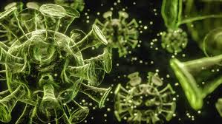

The Pandemic Control
NWA (Nerds With Attitude)

Slide 2
Project objective
Learn how a person can become affected by the pandemic and the effects of the vaccination

Slide 3

The Effects of Covid - 19
“COVID-19 has turned the world upside down. Everything has been impacted. How we live and interact with each other, how we work and communicate, how we move around and travel. Every aspect of our lives has been affected” ~ Sarah Nafziger, M.D., vice president for Clinical Support Services at UAB Hospital
Everything has changed, from the way we interact to how most businesses are ran

Slide 4
Problems to solve
1
Containment of the virus can be achieved through measures such as social distancing, wearing masks, hygiene, and contact tracing, and other measure.
3
The healthcare system can quickly become overwhelmed during a pandemic. It is crucial to manage the healthcare system's resources, including staff, equipment, and supplies, to ensure that patients receive the care they need.
Another critical challenge is to develop effective treatments and vaccines for the disease. Researchers and healthcare professionals need to work together to identify potential treatments and test them to determine their efficacy.
2
4
Pandemics can have severe economic consequences, including job losses, business closures, and decreased economic activity. It is essential to implement measures to support individuals and businesses affected by the pandemic. One essential way to bring the pandemic to an end is to add effective measures.

Slide 5
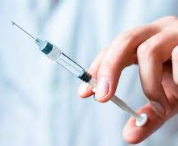
How Effective Different Vaccines Are
70.4% effectiveness of the ChAdOx1 nCoV-19 vaccine (AZD1222; Oxford-AstraZeneca) (Voysey et al., 2021),
95% effectiveness of the BNT162b2 mRNA COVID-19 vaccine (Pfizer-BioNTech) (Skowronski and De Serres, 2021),
94.1% effectiveness of the mRNA-1273 vaccine (Moderna) (Baden et al., 2021)
50.7% effectiveness of an absorbed COVID-19 (inactivated) vaccine (CoronaVac) (Palacios et al., 2020
The clear cut best Vaccine is the Pfizer vaccine with a 95% effectiveness out of the listed vaccines.

Slide 6
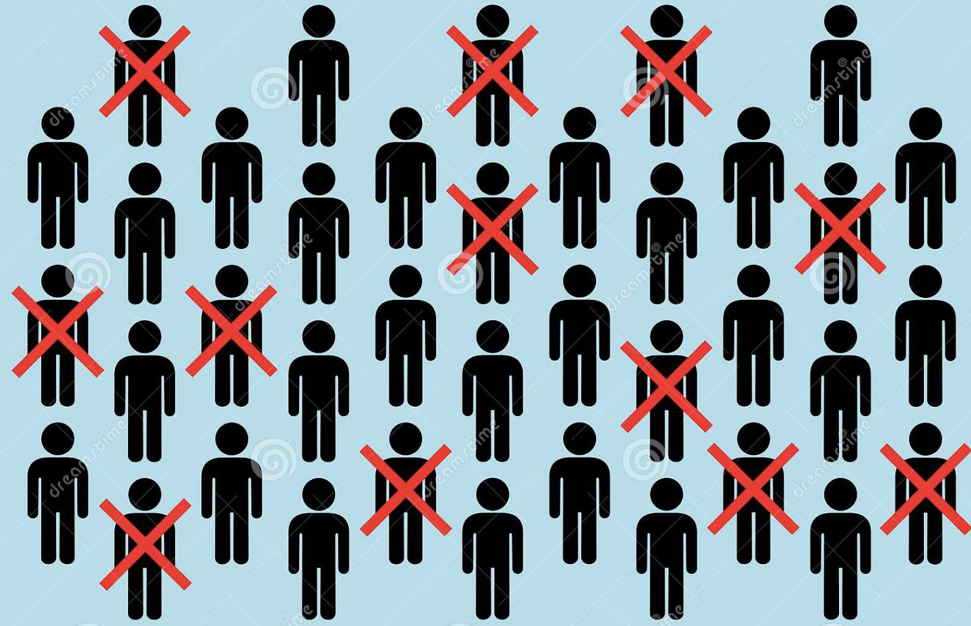
Mortality Rate of Covid -19 During 2020
239.4M
4.8M
2%
Confirmed Deaths
Million confirmed cases of Covid - 19
The global case fatality rate (CFR) for COVID-19 was estimated to be around 2%,

Slide 7
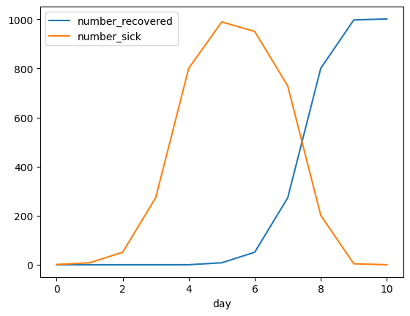
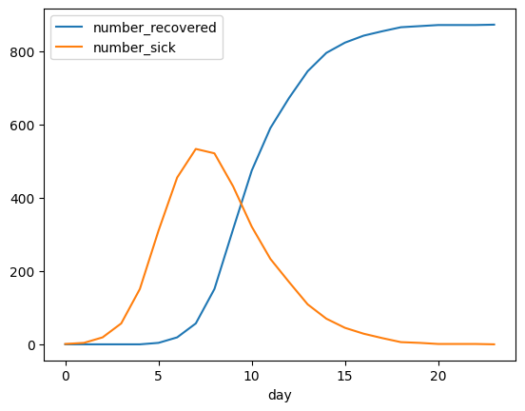
Trend Analysis Vaccine
According to the chart we can see that vaccines had significant improvement in recovery. This proves that the form of mitigation in the vaccine is highly effective. On the left is the graph without mitigations, and on the right is the graph with mitigations.

Slide 8

The Importance of Pfizer Vaccine
The clear cut best Vaccine is the Pfizer vaccine with a 95% effectiveness out of the listed vaccines.
This data is based on a small College of 1,000 students whereas::
10% with Mask
65% Have Been Vaccination
And all have various different interactions within each other

Slide 9
Verified Code
Github Link: https://github.com/NWA-Nerds-With-Attitudes/MS-CC-NWA-Vaccine-Code
What are we look at in this code:
In this code we can see a process on how we use data analysis in order to prepare statices, charts, and likelihood of the pandemic affecting a population of people who may or may not lick door knobs.

Slide 10
Thank you.

